Slide 1
Novos perfis profissionais/atributos de técnicos de saúde para o trabalho de PHC na pandemia".
José Francisco García Gutiérrez
Asesor Regional
Recursos Humanos para la Salud
OPS/OMS

Slide 2
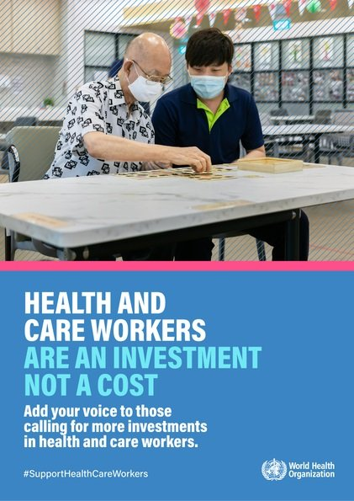
https://www.who.int/campaigns/annual-theme/year-of-health-and-care-workers-2021

Slide 3
Setting the scene: pre-pandemic
Global economy was projected to create around 40 million new health sector jobs by 2030¹
+++++++++++++++++++++++++
High income
+++++++++++++++++
+++++++++++++++++++++++++++++++++++++++++++++++++++++++++++++++++++++++++++++
Upper-middle income
+++++++-
DEMAND VS
NEED: PROJECTIONS TO 2030
Demand
++++++++++++++++++++++++++++++++++++++++++++++++
Lower-middle income
+++++++++++++++++++++++++++
Projected shortfall of 18 million health workers to achieve and sustain the SDGs²
+
Low income
+++++++++++++++++++++++++
1 World Bank, 2016 http://documents.worldbank.org/curated/en/546161470834083341/pdf/WPS7790.pdf
2 World Health Organization, 2016

Slide 4
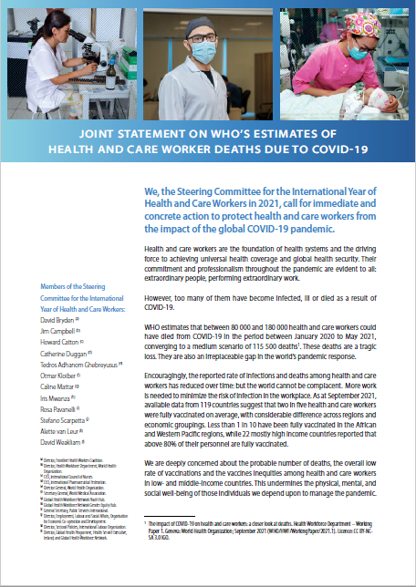
Protect health and care workers
The Steering Committee for the 2021 International Year of Health and Care Workers issued a Joint Statement calling for immediate and concrete action to protect health and care workers to:
Strengthen data collection and reporting on infections, ill-health and deaths among health and care workers due to COVID-19
Protect health and care workers during and beyond the current global COVID-19 pandemic
Accelerate the vaccination of all health and care workers in all countries
https://cdn.who.int/media/docs/default-source/2021-dha-docs/iyhcw_sc_joint_statement.pdf?sfvrsn=5fe331d2_5

Slide 5
Many health workers have died during the pandemic
However, SARS-CoV-2 infections in health workers have reduced over time
115 500 health workers globally, a conservative estimate, are believed to have died during the pandemic*
Better access to personal protective equipment (PPE) and COVID-19 vaccination have decreased SARS-CoV-2 infections in health workers over the course of the pandemic, yet their occupational service continues to put them at greater risk
Data as reported to WHO
*https://apps.who.int/iris/bitstream/handle/10665/345300/WHO-HWF-WorkingPaper-2021.1-eng.pdf

Slide 6
Health workforce lessons learned in COVID-19
Ensure adequate quantities and type of health workers.
Guarantee decent working conditions
Equip health workers with additional required skills and competencies
Enact rapid mobilization and re-deployment policies and mechanisms
Protect from infection (refresh/monitor IPC practices and ensure adequate PPE)
International solidarity to allow HRH investments
Agile work with partners to gather data, synthesize learning, innovate
Optimize roles
Notes:
Health and care workers are central to surge response and vaccine rollout…
We must protect human resources for health so they endure beyond the pandemic
We must invest in their learning, decent work and increasing their numbers
Together, we must prioritise action based on science, evidence and solidarity

Slide 7
Competencias niveles de gobierno
Compromiso político
Financiamiento sostenible
Infraestructuras
Recursos humanos

Slide 8
El eterno discurso Atención Primaria de Salud (APS)
3 años después de la Declaración de Astana
40 + 3 años después de la Declaración de Alma Ata
…. En tiempos de la Pandemia de COVID-19

Slide 9
APS en crisis permanente
Poco desarrollada en muchos países, poco financiada en otros
Dificultades para atraer y retener suficientes RHS
La mitad de la población mundial sin acceso a los servicios esenciales de salud
80%-90% de las necesidades de salud durante el curso de vida pueden cubrirse a través de APS resolutiva.
Envejecimiento y multimorbilidad: APS más necesaria que nunca

Slide 10
Cuatro Plataformas APS
Sistemas y servicios de salud basados en la persona, las familias y las comunidades)
Centros de salud de APS
Hospitales de primer nivel
Intervenciones comunitarias

Slide 11
APS más necesaria que nunca
Reclutamiento: Atracción & Retención
Apoyo intitucional: infraestructuras & tecnologías
Equipos interprofesionales de salud
Nuevos roles, nuevos perfiles, nuevos “curriculums”
Zonas rurales, remotas & subatendidas

Slide 17
THANKS

